Slide 1

Design, Modelling and Mathematical Formulations of PM-Free Special Machines: from Theory to Practice
MAY 18, 2025
Doga Ceylan, Mitrofan Curti, Joost van Zwieten
Electromechanics and Power Electronics (EPE) Research Group
Notes:
Hi everybody, welcome to this Tutorial session. Today in this session, we are gonna discuss about PM-free electrical machines and specific focus will be on dc-excited reluctance machines.

Slide 2
Content
Part 1: Permanent-magnet-free (PM-free) electrical machines
Reluctance machines for heavy-duty applications
Modeling, design, prototyping, and drive challenges
Part 2: Towards an optimal drive of dc-excited PM-free machines
Governing field equations
Numerical implementation
Part 3: Hands-on session based on Nutils – an open-source software
Modeling the reluctance principle
A dc-excited PM-free machine simulation and optimization
Electromechanics and Power Electronics
Notes:
Here is the outline. This talk will consist of 3 parts. And each part will be presented by different presenter.
In the first part I will give a motivation on PM-free electrical machines and I will take a use case scenario of heavy-duty vehicles and the challenges in electrifying heavy-duty operations without PM materials
In the second part my colleague Mitrofan will go into details of governing field equations for dc-excited reluctance machines and numerical implementations
In the last part Joost will give you a hands-on session where you will discover this software and build your own code for optimal drive of variable flux reluctance machines

Slide 3
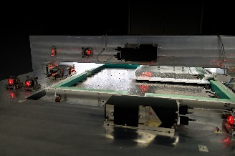
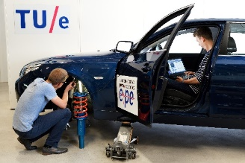
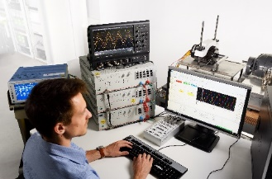
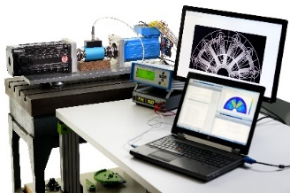
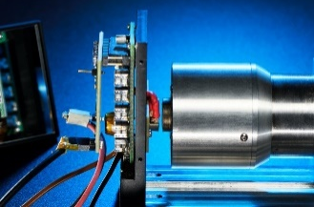
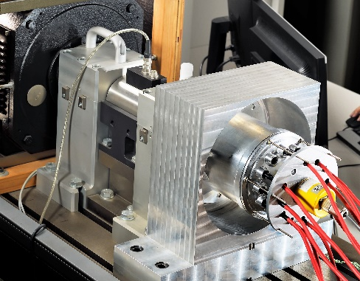
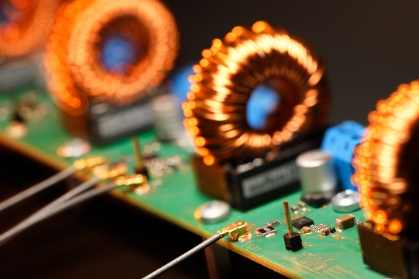
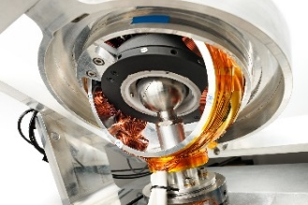
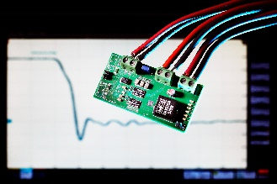
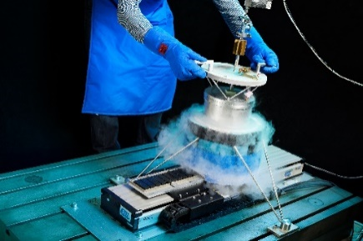
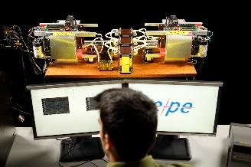
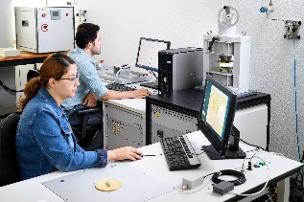
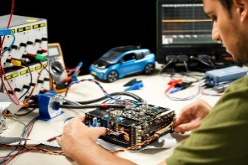
EPE Group at TU/e
High-precision mechatronics
Electric mobility
Electric drives
Multi-physics modeling
Contactless energy transfer
Electrical machines
Power electronics
Advanced actuators
High-frequency PE
Superconducting machines
Isolated converters
Material characterization
EV charging
Electromechanics and Power Electronics
https://www.tue.nl/en/research/research-groups/electromechanics-and-power-electronics
Notes:
Before starting the topic of the tutorial, I would like to use this chance to give you some details about our research group Electromechnais and power electronics group at the Eindhoven University of Technology.
In our research group, we are working on various classes of research topics on EM and PE, some of them are given here …
Todays session could be defined under electric mobility.

Slide 4
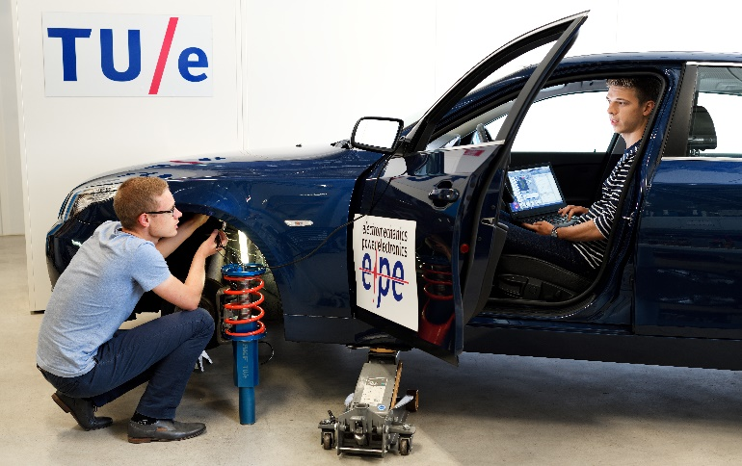
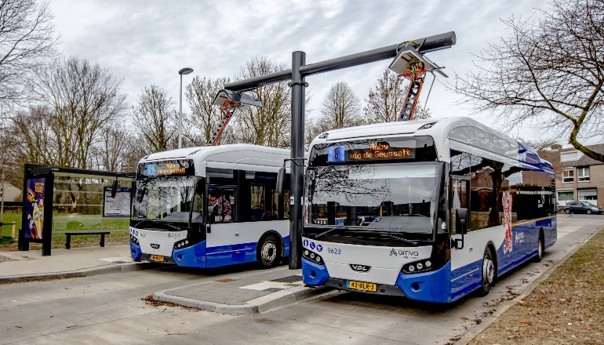
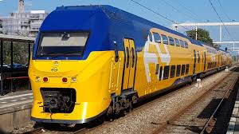
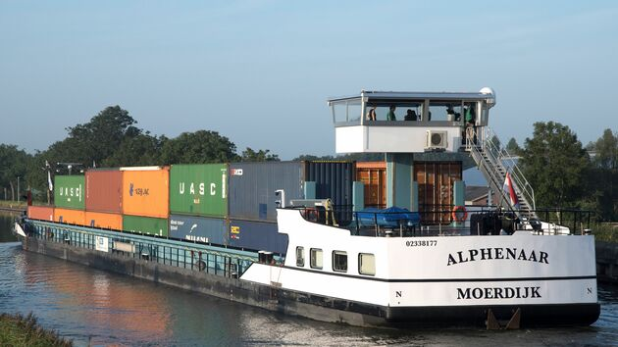
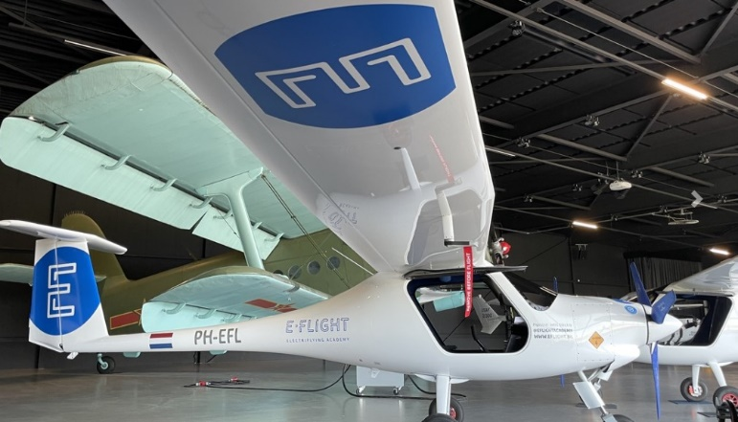
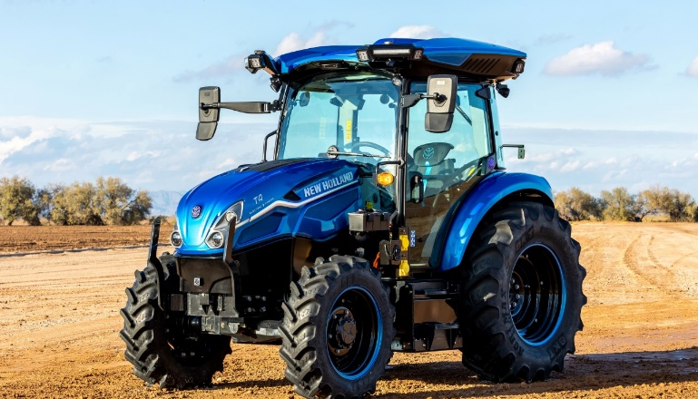
Electric mobility
Electromechanics and Power Electronics
Notes:
When we talk about electric mobility, as you all know we need to consider various types of vehicles: passenger cars, public transportation, tractors, vessels, airplanes, and trains.

Slide 5

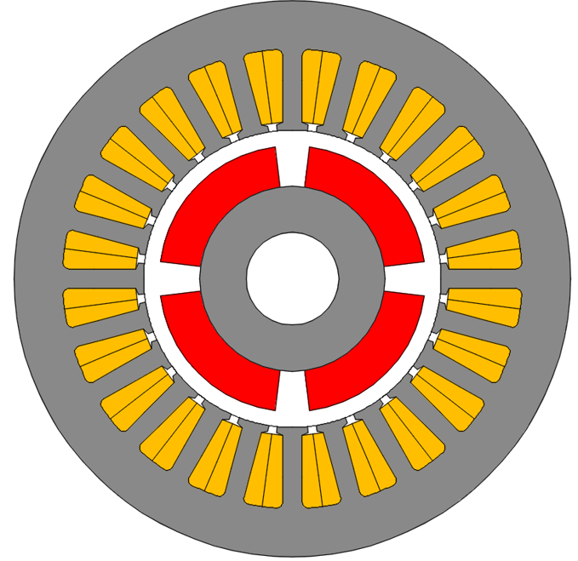
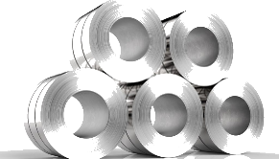
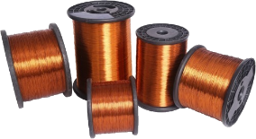
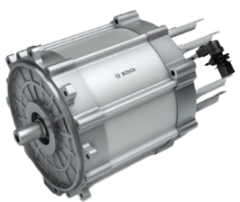
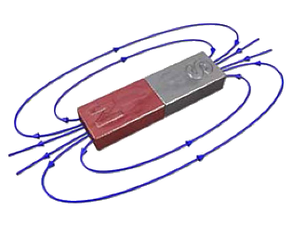
Electric mobility
steel
High efficiency
High power density
However!
θ
ac windings
r
permanent magnets
Electromechanics and Power Electronics
Notes:
And as I mentioned today we will focus on heavy-duty vehicles such as electric tractors. In the electrification of such vehicles electrical machines is the one of the most critical components for the overall vehicle performance. PMSM are mostly employed in the Evs due to their high efficiency and power density. However….

Slide 6

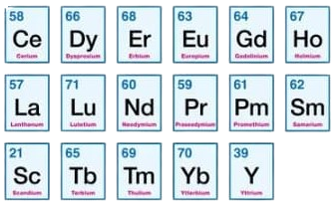
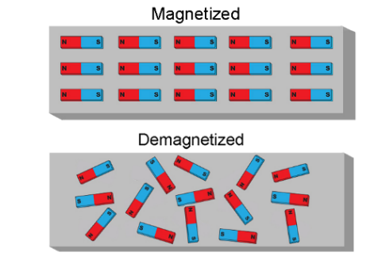

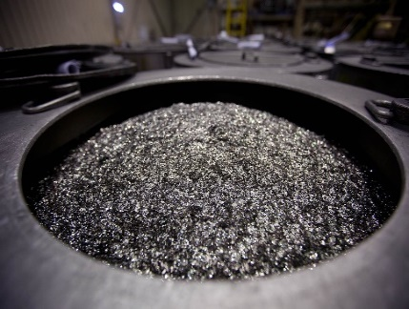

Permanent-magnet based electrical drives
high cost
scarcity
demagnetization
limited supply
complex recycling
pollution in mines
New type of permanent-magnet-free electrical machines
Electromechanics and Power Electronics
Notes:
Using PM materials in Evs comes with many disadvantages. First of all they are very expensive and scarce materials. They lose their magnetic properties under high temperature and magnetic field. There is limited supply on the earth. Their recycling process is very complex. And there are a lot of pollution in their mines.
Therefore we need new type of PM-free electrical machines.

Slide 7
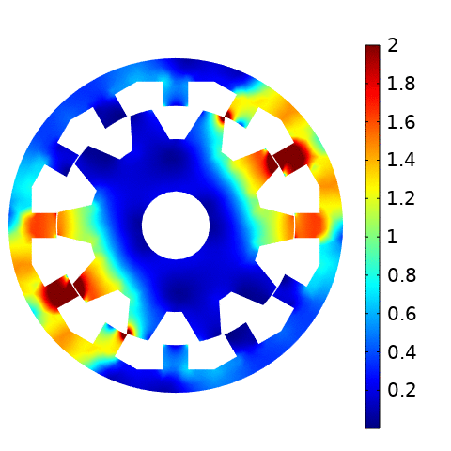
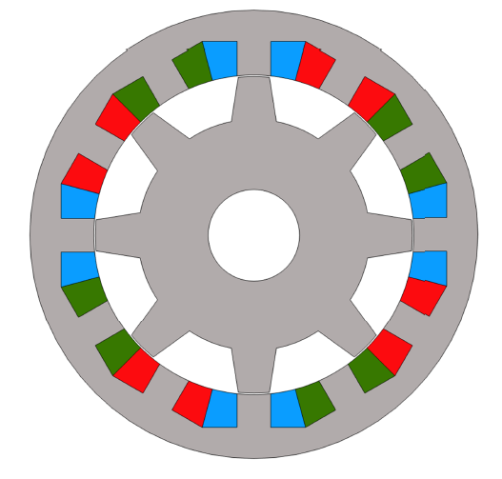
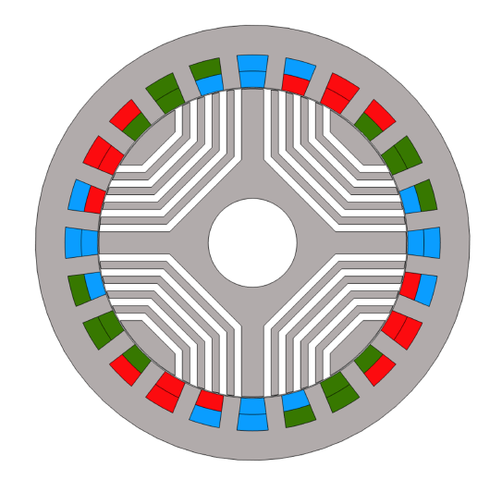
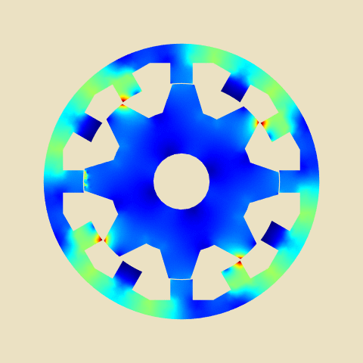
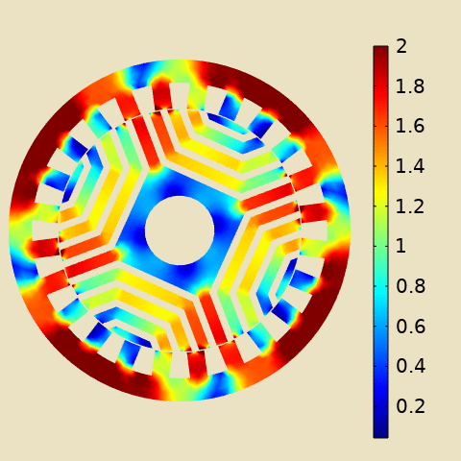
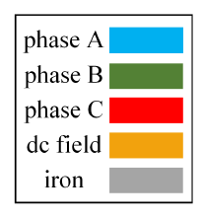

Conventional PM-free electrical machines
Switched
reluctance machine (SRM)
Synchronous reluctance machine (SynR)
[T]
SRM:
Non-sine excitation
Complex control
Large ripple
SynR:
Complex rotor structure
Distributed windings
D. Ceylan, and K. O. Boynov “A comparative study between PM-free reluctance machines for heavy-duty vehicles,” 17th International Conference on Magnetics (INTERMAG), 2024
Electromechanics and Power Electronics
Notes:
SRM and SynR machine topologies are two conventional PM-free electrical machines.
In our research group we have been working on these type of machines for the electrification of heavy-duty systems.
However, these topologies have some critical disadvanteges.
SRM has non-sine current excitation which leads to complex control and large torque ripple
SynR has a complex rotor structure which is problematic for high-speed operations and it has distributed windings with high copper losses

Slide 8
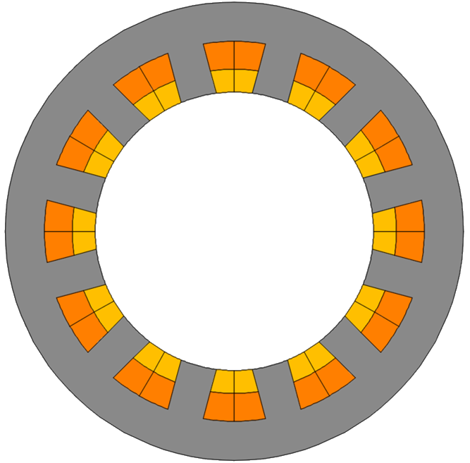
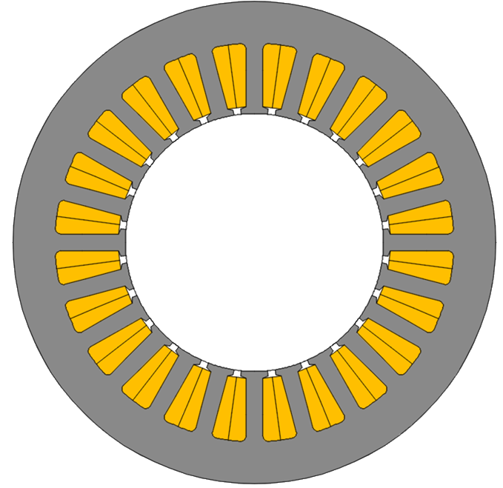
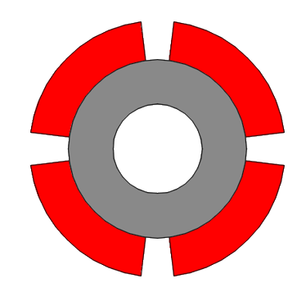

DC-excited reluctance machines
Robust and cheap
No demagnetization
No source in rotor
Windings in stator
Lower power density
Magnetic saturation
steel
θ
ac windings
r
dc windings
permanent magnets
Electromechanics and Power Electronics
Notes:
Therefore, dc-excited reluctance machines can be a promising alternative to PM-based machines in addition to the conventional reluctance topologies
`The rotor of PM machine is replaced with a salient rotor without any excitation or PM material
In the stator additional dc-field windings are introduced addition to the ac windings

Slide 9
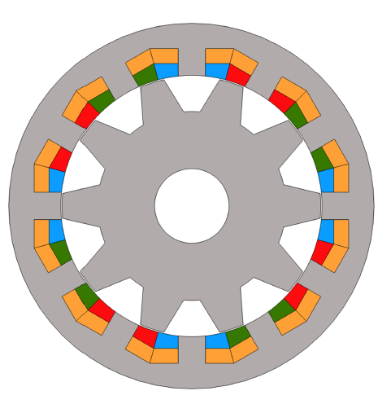
Variable flux reluctance machine
Modeling
Electromagnetic and thermal solver
Material properties
Design framework
Heavy-duty vehicles
High torque and high speed
Prototyping
Steel, coils, cooling
Electric drive
Control algorithms
Excitation sequence
Electromechanics and Power Electronics
Notes:
In the rest of the tutorial, we will focus on dc-excited reluctance machines
Here you see the main challenges in utilizing VFRMs in heavy-duty applications
These challenges are….

Slide 10
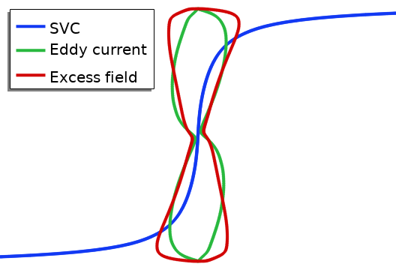
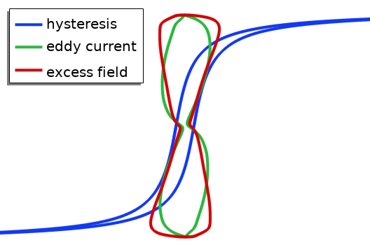
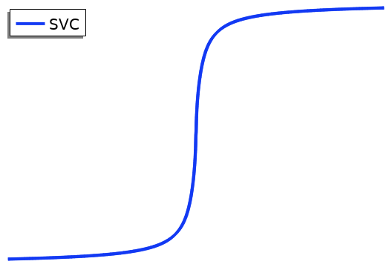
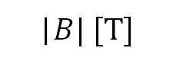
Modeling challenges
B
|$B| [T]$
Nonlinear magnetic characteristics of laminated rotor and stator electrical steel
Customized simulation tools for specific applications
Magnetostatic model with the single valued curve (SVC)
Magnetodynamic model with the single valued curve (SVC)
Magnetodynamic model with hysteresis characteristics
Accurate modeling
H
D. Ceylan, R. Zeinali, B. Daniels, K. O. Boynov, and E. A. Lomonova, “Magnetodynamic finite element analysis coupled with a vector hysteresis model applied to a variable flux reluctance machine,” IEEE Trans. Ind. Appl., vol. 60, no. 1, pp. 80–92, Jan. 2024.
Electromechanics and Power Electronics
Notes:
Lets start with modeling challenges:
First of all, these machines operates under local magnetic saturation, therefore the nonlinear magnetic characteristics of laminated steel has to be coupled with the electromagnetic solver
For this purpose, we have been proposing three approaches:
The first one the most common approach with magnetostatic model coupled with SVC: the disadvantage is that high frequency and hysteresis fields are not included in the system of equations
The second approach is the magnetodynamic model with SVC: advantage is the high frequency fields (eddy and excess fields) are included in the model (not post-processing) using a weak formulation, however, the hysteresis loss has to be calculated using post-processing
The last approach is the magnetodynamic model with a hysteresis model: this is the most realistic and computationaly expensive model which provides the most accurate field calculation.

Slide 11
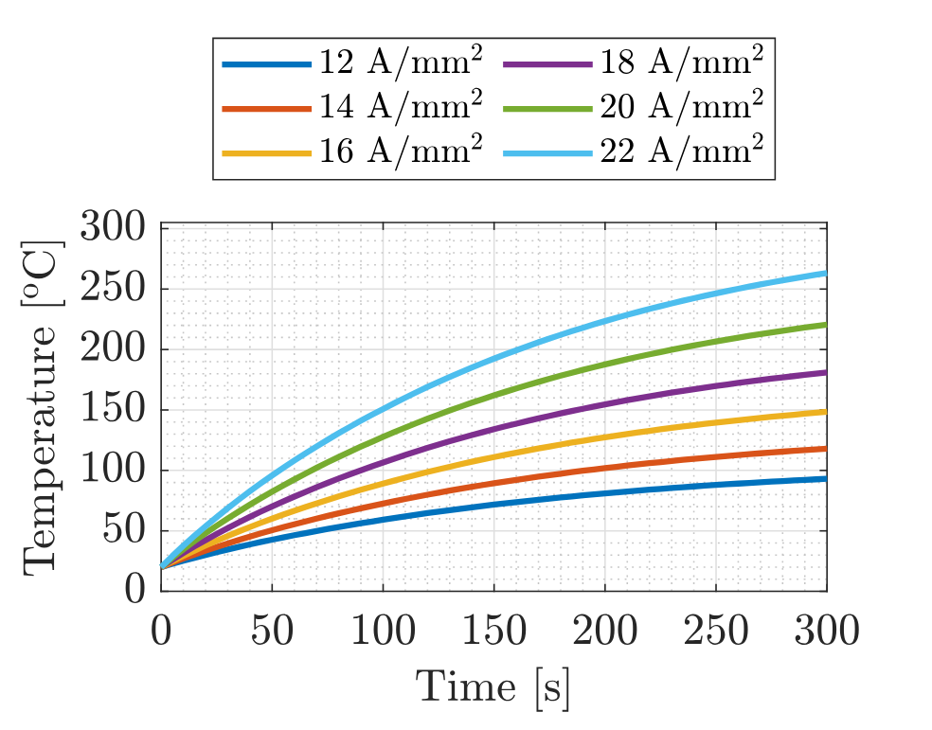
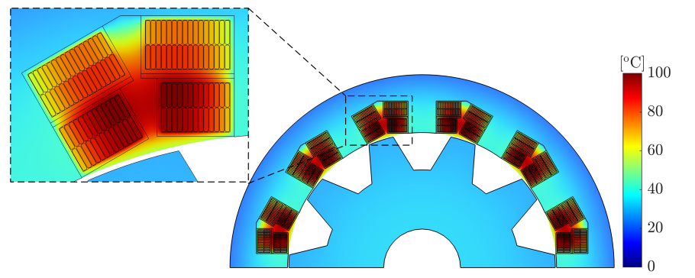
Modeling challenges
Heat transfer model coupled with the electromagnetic solver including copper and iron losses:
conductive heat transfer within windings and laminations
conduction in the air gap and cooling body
Over loading analysis in transient
D. Ceylan, “Mathematical and experimental frameworks for iron-based electromagnetic devices: Applied to variable flux reluctance machines for heavy-duty applications,” Ph.D. dissertation, Eindhoven University of Technology, The Netherlands, 2023.
Electromechanics and Power Electronics
Notes:
Another modeling challenge is the thermal modeling which requires a coupling with the magnetic model
The copper and iron losses calculated by the magnetic model hasto be used in the thermal model as the input
Conductive heat transfer within the iron and windings has to be modeled accurately
Additionally, the conduction in the airgap and the cooling system (usually water jacket for heavy-duty) has to be also estimated
Here you can see the temperature distribution at steady state for the continuous nominal operation
Besides the nominal operation, over loading is critical for the machine which requires a transient thermal model

Slide 12
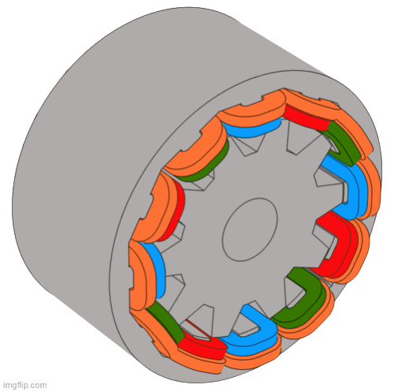
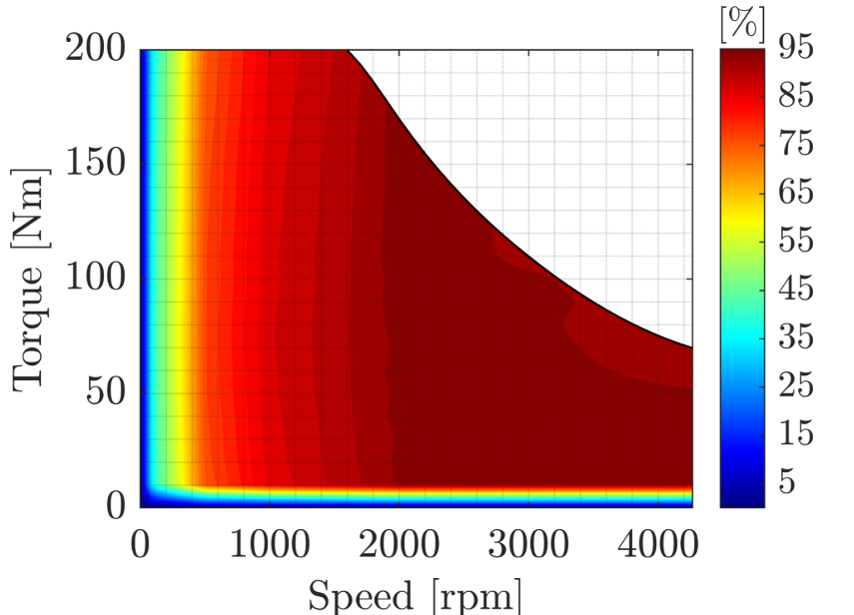
Design framework
Application-oriented flexible design framework
A 30-kW high-torque variable flux reluctance (VFRM) machine for heavy-duty vehicle
Considering both constant-torque and flux-weakening regions
D. Ceylan, K. O. Boynov, E. A. Lomonova, “Multi-objective optimization of a variable flux reluctance machine for high-torque operations,” International Conference on Computation of Electromagnetic Fields (COMPUMAG), 2022.
Electromechanics and Power Electronics
Notes:
Development of a design framework is another challenge which should be application oriented:
This can be done by two approaches: 1 is including critical operating points, 2 is designing based on a typical torque-speed cycle
Here you see the final design geometry of a 30 kW VFRM for heavy-duty vehicle
The design is done by including two operating points at nominal and maximum speed, and as you can see the efficiency is around 90% at the nominal speed to generate 200 Nm output torque

Slide 13
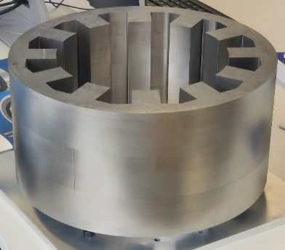
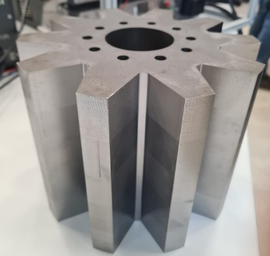
Manufacturing challenges
Laser cutting of the laminations
Stator laminations
Rotor laminations
D. Ceylan, M. Merdzan, F. Sweegers, E. A. Lomonova, “A permanent-magnet-free electrical drive for heavy-duty electric vehicles in agricultural sector,” Demonstrator project proposal (TTW 19858) granted by the Netherlands Organization for Scientific Research (NWO), 2022.
Electromechanics and Power Electronics
Notes:
Additionally, there are some manufacturing challenges:
The first one is manufacturing of the laminated stator and rotor structures
NO27 laminated steel is used for the prototype. Laser cutting is applied to reduce the price

Slide 14
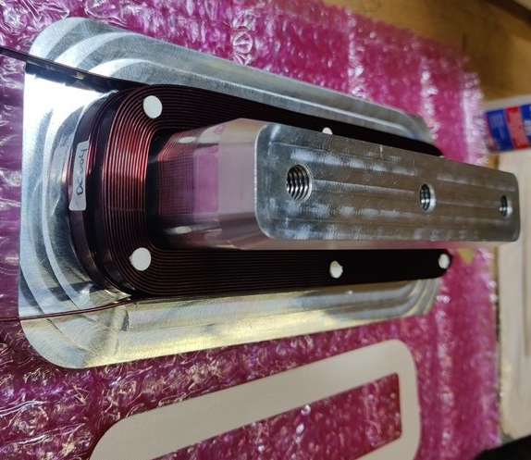
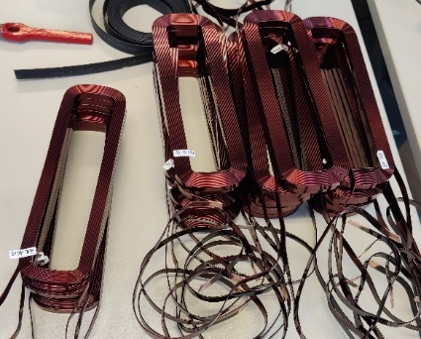
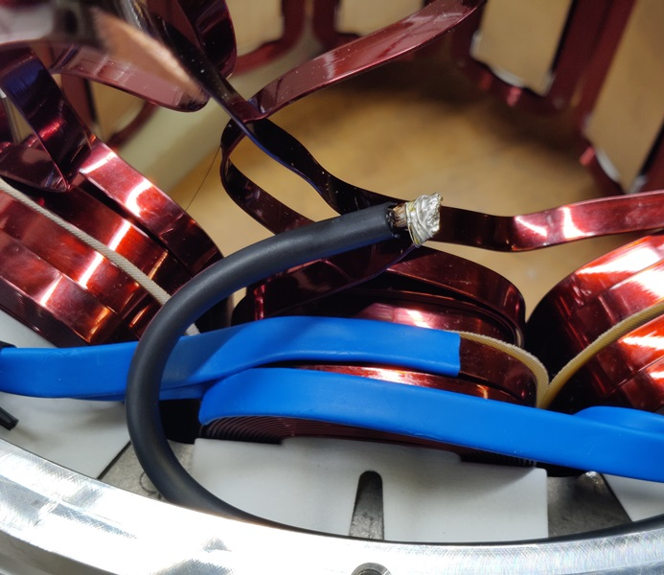
Manufacturing challenges
Pre-winded coils
D. Ceylan, M. Merdzan, F. Sweegers, E. A. Lomonova, “A permanent-magnet-free electrical drive for heavy-duty electric vehicles in agricultural sector,” Demonstrator project proposal (TTW 19858) granted by the Netherlands Organization for Scientific Research (NWO), 2022.
Electromechanics and Power Electronics
Notes:
Flat wires are used for dc and ac field windings
Pre-winding is applied through a tooth mold
End windings are manufactured by soldering

Slide 15


Manufacturing challenges
Installation and potting of the windings
D. Ceylan, M. Merdzan, F. Sweegers, E. A. Lomonova, “A permanent-magnet-free electrical drive for heavy-duty electric vehicles in agricultural sector,” Demonstrator project proposal (TTW 19858) granted by the Netherlands Organization for Scientific Research (NWO), 2022.
Electromechanics and Power Electronics
Notes:
Pre-winded windings are installed within the stator while temperature sensors are also included
The potting has been implementesd to the installed windings to improve the thermal characteristics

Slide 16


Manufacturing challenges
Integration of the water cooling
D. Ceylan, M. Merdzan, F. Sweegers, E. A. Lomonova, “A permanent-magnet-free electrical drive for heavy-duty electric vehicles in agricultural sector,” Demonstrator project proposal (TTW 19858) granted by the Netherlands Organization for Scientific Research (NWO), 2022.
Electromechanics and Power Electronics
Notes:
The water jacket is also integrated to the outside of the stator
Paralel cooling channels are used
On the left side you can see the finalized prototype ready for testing

Slide 17


Electric drive challenges
Four quadrant motor test setup
D. Ceylan, M. Merdzan, F. Sweegers, E. A. Lomonova, “A permanent-magnet-free electrical drive for heavy-duty electric vehicles in agricultural sector,” Demonstrator project proposal (TTW 19858) granted by the Netherlands Organization for Scientific Research (NWO), 2022.
Electromechanics and Power Electronics
Notes:
A four quadrant motor test rig is used for the experments.
An induction machine is used for loading
4 legs power converter has been designed for the excitation of the VFRM. 3 legs are used as 3 phase inverter and the 4th leg is used for dc/dc conversion for the extication of the dc field windings

Slide 18


Electric drive challenges
Development of control algorithms
D. Ceylan, M. Merdzan, F. Sweegers, E. A. Lomonova, “A permanent-magnet-free electrical drive for heavy-duty electric vehicles in agricultural sector,” Demonstrator project proposal (TTW 19858) granted by the Netherlands Organization for Scientific Research (NWO), 2022.
Electromechanics and Power Electronics
Notes:
Conventional field oriented control algorithm is developed in Simulink environment and here you can see the response of the motor during the current control when the reference ac and dc currents change

Slide 19

Electric drive challenges
Selection of the excitation sequence
D. Ceylan, K. O. Boynov, and E. A. Lomonova “Post-processing-based flux-weakening control of variable flux reluctance machines,” 21st IEEE Conference on Electromagnetic Field Computation (CEFC), 2024
Electromechanics and Power Electronics
Notes:
However, when the machine operates beyond its base speed the drive problem is getting more compicated
In conventional PM machines –Id is applied to weaken the flux to operate the machine within its voltage limit.
In VFRM, there is another alternative to do that which is reducing the dc field current
-Id results in high copper loss in FW
Reducing Idc results in lower output power
So which one is better? Actually non of them, an optimal combination of both has to be applied.

Slide 20

Electric drive challenges
Selection of the excitation sequence
D. Ceylan, K. O. Boynov, and E. A. Lomonova “Post-processing-based flux-weakening control of variable flux reluctance machines,” 21st IEEE Conference on Electromagnetic Field Computation (CEFC), 2024
Electromechanics and Power Electronics

Slide 21
Outline part 2
Governing field equations
Numerical implementation
Torque and flux computation
Formulation of the optimization problem
Electromechanics and Power Electronics

Slide 22












Governing field equations
Ampére’s law with static assumption
Constitutive relation
$$∇×\vec{H}=\vec{J}$$
Definition of magnetic vector potential
$$\vec{B} =μ \vec{H} + {\vec{B}}_{rem}$$
$$\vec{B}=∇×\vec{A}$$
$$\vec{H}=ν \vec{B}−ν{\vec{B}}_{rem}$$
Expression of Magnetic Vector Potential
MVP expression in Einstein notation
$$∇×\left(ν∇×\vec{A}\right)=\vec{J}+∇×ν{\vec{B}}_{rem}$$
$$y$$
$$−∇_{i}\left(ν∇_{i}A_{2}\right)=J_{2}+νe_{i}{B_{rem}}_{i}$$
Dimensionality reduction to 2D problem
$$x$$
$$e_{i}={\left[\begin{matrix}∇_{0} & −∇_{1}\end{matrix}\right]}^{T}$$
$$−∇⋅\left(ν∇A_{z}\right)=J_{z}+ν(∂_{x}B_{{rem}_{y}}−∂_{y}B_{{rem}_{x}})$$
$$x_{1}$$
$∇_{i}$ - Gradient w.r.t$i−$th axis
$$x_{0}$$
Electromechanics and Power Electronics

Slide 23






Boundary conditions
Flux not leaving the stator, i. e.
$A_{2}\left(x_{i}\right)=0$, for all $x_{i} ∈Γ_{out}$
Geometric periodicity
If $(r,θ)∈Γ_{p}$ then $\left(r,θ+π\right)∈Γ_{p}$
Continuity and rotation – rotor-stator interface
$A_{2r}=A_{2s}$, and $ν∇_{i}A_{2r}n_{i}=ν∇_{i}A_{2s}n_{i}$
where: $A_{2r}\left(x_{i}\right)=A_{2}\left(x_{i}\right) for x_{i}∈Γ_{r}$
$A_{2s}\left(x_{i}\right)=A_{2}\left(x_{i}\right) for x_{i}∈Γ_{s}$
$$Γ_{out}$$
$$Γ_{r},Γ_{s}$$
$$θ$$
$$Γ_{p}$$
$$r$$
$$x_{1}$$
$$x_{0}$$
Electromechanics and Power Electronics

Slide 24





Numerical implementation
The Galerkin method seeks an approximate solution with trial functions. We seek for a zero residual for a set of test functions. The projection of the residual on the test functions is performed with the help of inner product.
$∇_{i}\left(ν∇_{i}A_{2}^{∗}\right)+J_{2}=R$ with $A_{2}^{∗}=a_{n}β_{n}(x_{i})$ where $x_{i}∈Ω$
With:
The weak form is obtained from the inner product
$λ\left(x_{i}\right)=l_{n}$ $β_{n}(x_{i})$ for $x_{i}∈Γ_{r}$
$$\int_{Ω}{R⋅βdΩ}=\int_{Ω}{\left(∇_{i}\left(ν∇_{i}A_{2}^{∗}\right)+J_{2}\right)⋅βdΩ}=0$$
and:
The integration by parts offers conforming $H$ field:
$θ$ – a rotation map
$$\int_{Ω}{(∇_{i}β\left(ν∇_{i}A_{2}^{∗}\right)+J_{2}⋅β)dΩ}+\int_{∂Ω}{β\left(ν∇_{i}A_{2}^{∗}\right)n_{i}∂Ω}=0$$
The use of Lagrangian multiplier to couple $∂Ω_{s}$ and $∂Ω_{r}$
$$\int_{∂Ω_{r}}{λ\left(x_{i}\right)[A_{2r}−A_{2s}(θ)]∂Ω_{r}}=0$$
Electromechanics and Power Electronics

Slide 25






Computation of torque
Torque from the Maxwell stress tensor
$$T=\frac{l}{μ_{0}}\int_{0}^{2π}{B_{r}B_{θ}r^{2}dθ}$$
With: $l$- motor length
$B_{r}, B_{θ}$- radial and tangential field
Stator
Airgap
Rotor
Consider infinite lines in the airgap area
$$x_{1}$$
$$T=\frac{l}{μ_{0}(r_{out}−r_{int})}\int_{r_{int}}^{r_{out}}{\int_{0}^{2π}{B_{r}B_{θ}r^{2}dθ}}$$
$$r_{in}$$
$$r_{out}$$
$$x_{0}$$
Finally, consider the integral in the airgap
$$T=\frac{l}{μ_{0}(r_{out}−r_{int})}\int_{S_{gap}}{B_{r}B_{θ}rdS}$$
A. Arkkio, “Analysis of induction motors based on the numerical solution of the magnetic field and circuit equations,” Ph.D. dissertation, Lab. Electromech., Helsinki Univ. Technol., Espoo, Finland, 1987.
Electromechanics and Power Electronics

Slide 26














Computation of flux
Flux is defined from total field crossing a given area
$$n_{i}$$
$$ψ=\int_{S_{t}}{B_{i}n_{i}dS_{t}}$$
$$ψ=\int_{S_{t}}{ε_{ijk}∇_{j}A_{k}n_{i}dS_{t}}$$
$$S_{t}$$
$${dl}_{i}$$
With Stokes theorem, the integral on contour is
$$J_{i}$$
$$ψ=\oint_{L}{A_{i}dl_{i}}$$
$$ψ=\oint_{L}{\frac{1}{\int_{S}{ds}}\int_{S(l)}{A_{i}dSdl_{i}}}$$
$$n_{i}$$
Finally, for 2D problems
$${−l}_{2}$$
$${+l}_{2}$$
$$ψ=\frac{L_{s}}{\int_{S^{−}}{dS}}\int_{S^{−}}{A_{2}dS−\frac{L_{s}}{\int_{S^{+}}{dS}}\int_{S^{+}}{A_{2} dS}}$$
$$S^{−}$$
$$S^{+}$$
Electromechanics and Power Electronics

Slide 27




Three methods to compute iron losses
Losses computed in post processing phase
$$P_{loss}=P_{hys}+P_{eddy}+P_{exc}$$
Only hysteresis computed in post processing phase
$$\vec{H}={\vec{H}}_{svc}+\underset{H_{dyn}}{\underbrace{{\vec{H}}_{cl}+{\vec{H}}_{ex}}}$$
Full hysteresis implementation
$$\int_{Ω}{(∇_{i}β\left(H_{i}^{∗}\right)+J_{2}⋅β_{n})dΩ}+\int_{∂Ω}{β\left(H_{i}\right)n_{i}∂Ω}=0$$
Where: $H_{i}=ℒ_{hys}(B_{i})$
D. Ceylan, et. al., “A novel modeling technique via coupled magnetic equivalent circuit with vector hysteresis characteristics of laminated steels,” IEEE Trans. Ind. Appl., vol. 59, no. 2, pp. 1481–1491, Mar. 2023.
B. Daniels, et. al., “Everett Map Construction for Modeling Static Hysteresis: Delaunay-Based Interpolant Versus B-Spline Surface,” IEEE Transactions on Magnetics, vol. 59, no. 5, pp. 1–4, May 2023
Electromechanics and Power Electronics
Notes:
Magnetostatic single valued -> Bertotti curve fitting
Magnetodynamic with single valued -> eddy current and excess field implemented in the weak form -> Bertotti for the hysteresis part (only for hysteresis part)
Implementation of hysteresis model in the weak form (losses from the area of the loop)

Slide 28

Quantification of losses
Iron losses
Copper losses
D. Ceylan, “Mathematical and experimental frameworks for iron-based electromagnetic devices: Applied to variable flux reluctance machines for heavy-duty applications,” Ph.D. dissertation, Eindhoven University of Technology, The Netherlands, 2023.
Electromechanics and Power Electronics

Slide 29




Optimization problem
$$\min_{I_{q}, I_{dc}}{(R_{f}I_{dc}^{2}+\frac{3}{2}R_{ph}I_{q}^{2})}$$
subject to $T_{e,ref}$
$$\min_{I_{q}, I_{dc}, I_{d}}{(R_{f}I_{dc}^{2}+\frac{3}{2}R_{ph}\left(I_{d}^{2}+I_{q}^{2}\right))}$$
subject to $T_{e,ref}$
G. H. Bayazit et. al., “Maximum-torque-per-watt control framework for variable flux reluctance machines with magnetic saturation and cross-coupling,” International Magnetic Conference (INTERMAG), 2024.
Electromechanics and Power Electronics

Slide 30
Hands-on session
You will be using the open-source FEM library Nutils (https://nutils.org) to perform simulations of a variable flux reluctance machine. Visit
https://github.com/evalf/iemdc2025
for installation instructions and exercises.
To run remotely (limited users), please access:
https://iemdc.evalf.com
Electromechanics and Power Electronics

Slide 31
Design, Modelling and Mathematical Formulations of PM-Free Special Machines: from Theory to Practice
Thank you for your attention
MAY 18, 2025
Doga Ceylan, Mitrofan Curti, Joost van Zwieten
Electromechanics and Power Electronics

